Slide 1


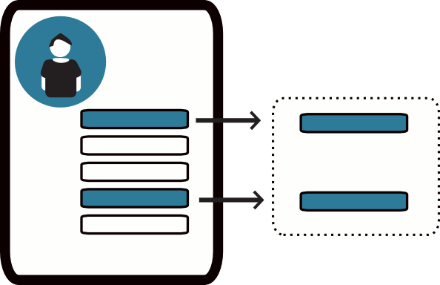




PROCESS
INPUT
OUTPUT
Data Analytics
Profile Data
Child Profile
Decision Support System
MySql Database
CodeIgniter MVC Framework
Medical History
Recommended Nutrition/Treatment
PHP
CSS
HTML5
Javascript
Health Status

